Slide 1







Recipe Tracking App
Richo Winson Tandoto ( 14558830 )

Slide 2
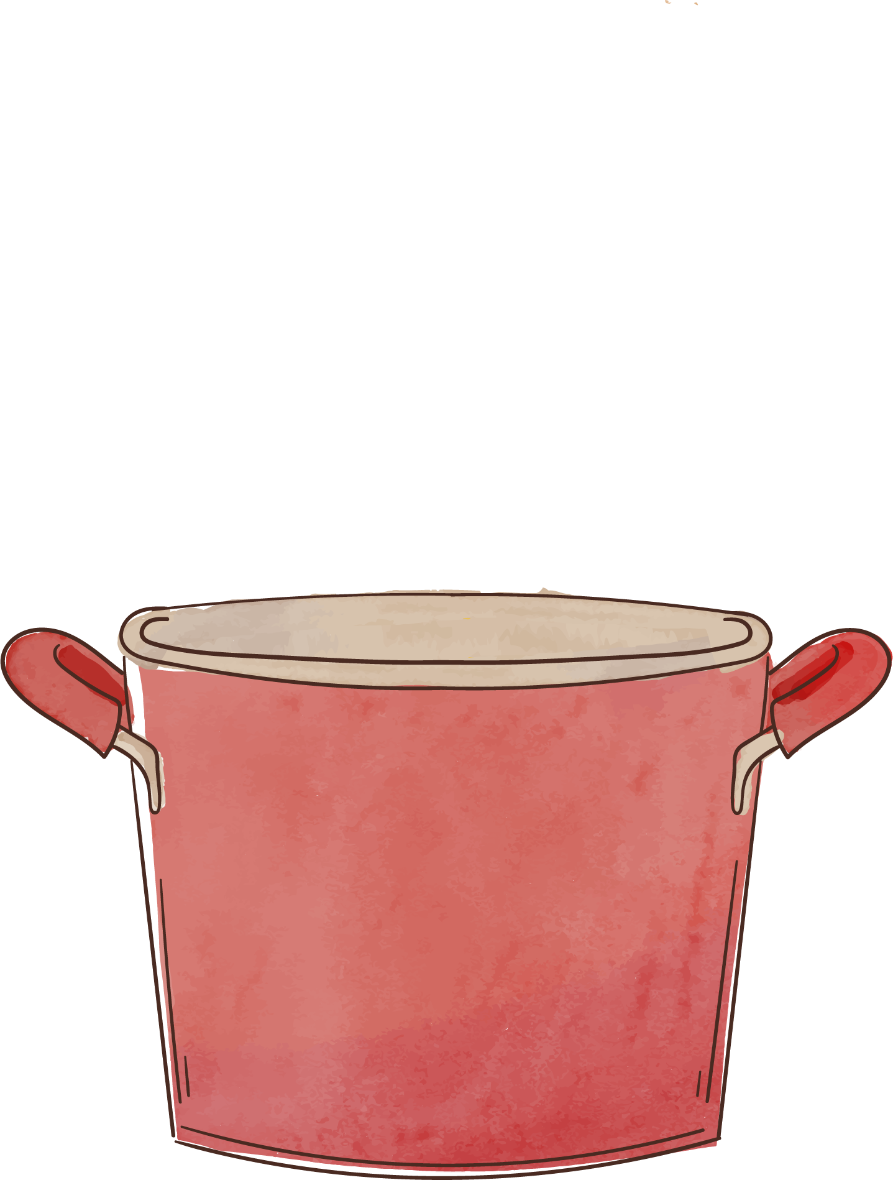
Problems
01
02
03
04
Online recipes
Communication
Recipes found online are often misleading or inconsistent
Limited way to discuss recipes with other passionate cookers
Dietary preferences
Recipe Sharing
No consistent way to filter preferences online
No convenient way to share recipes to other people

Slide 3
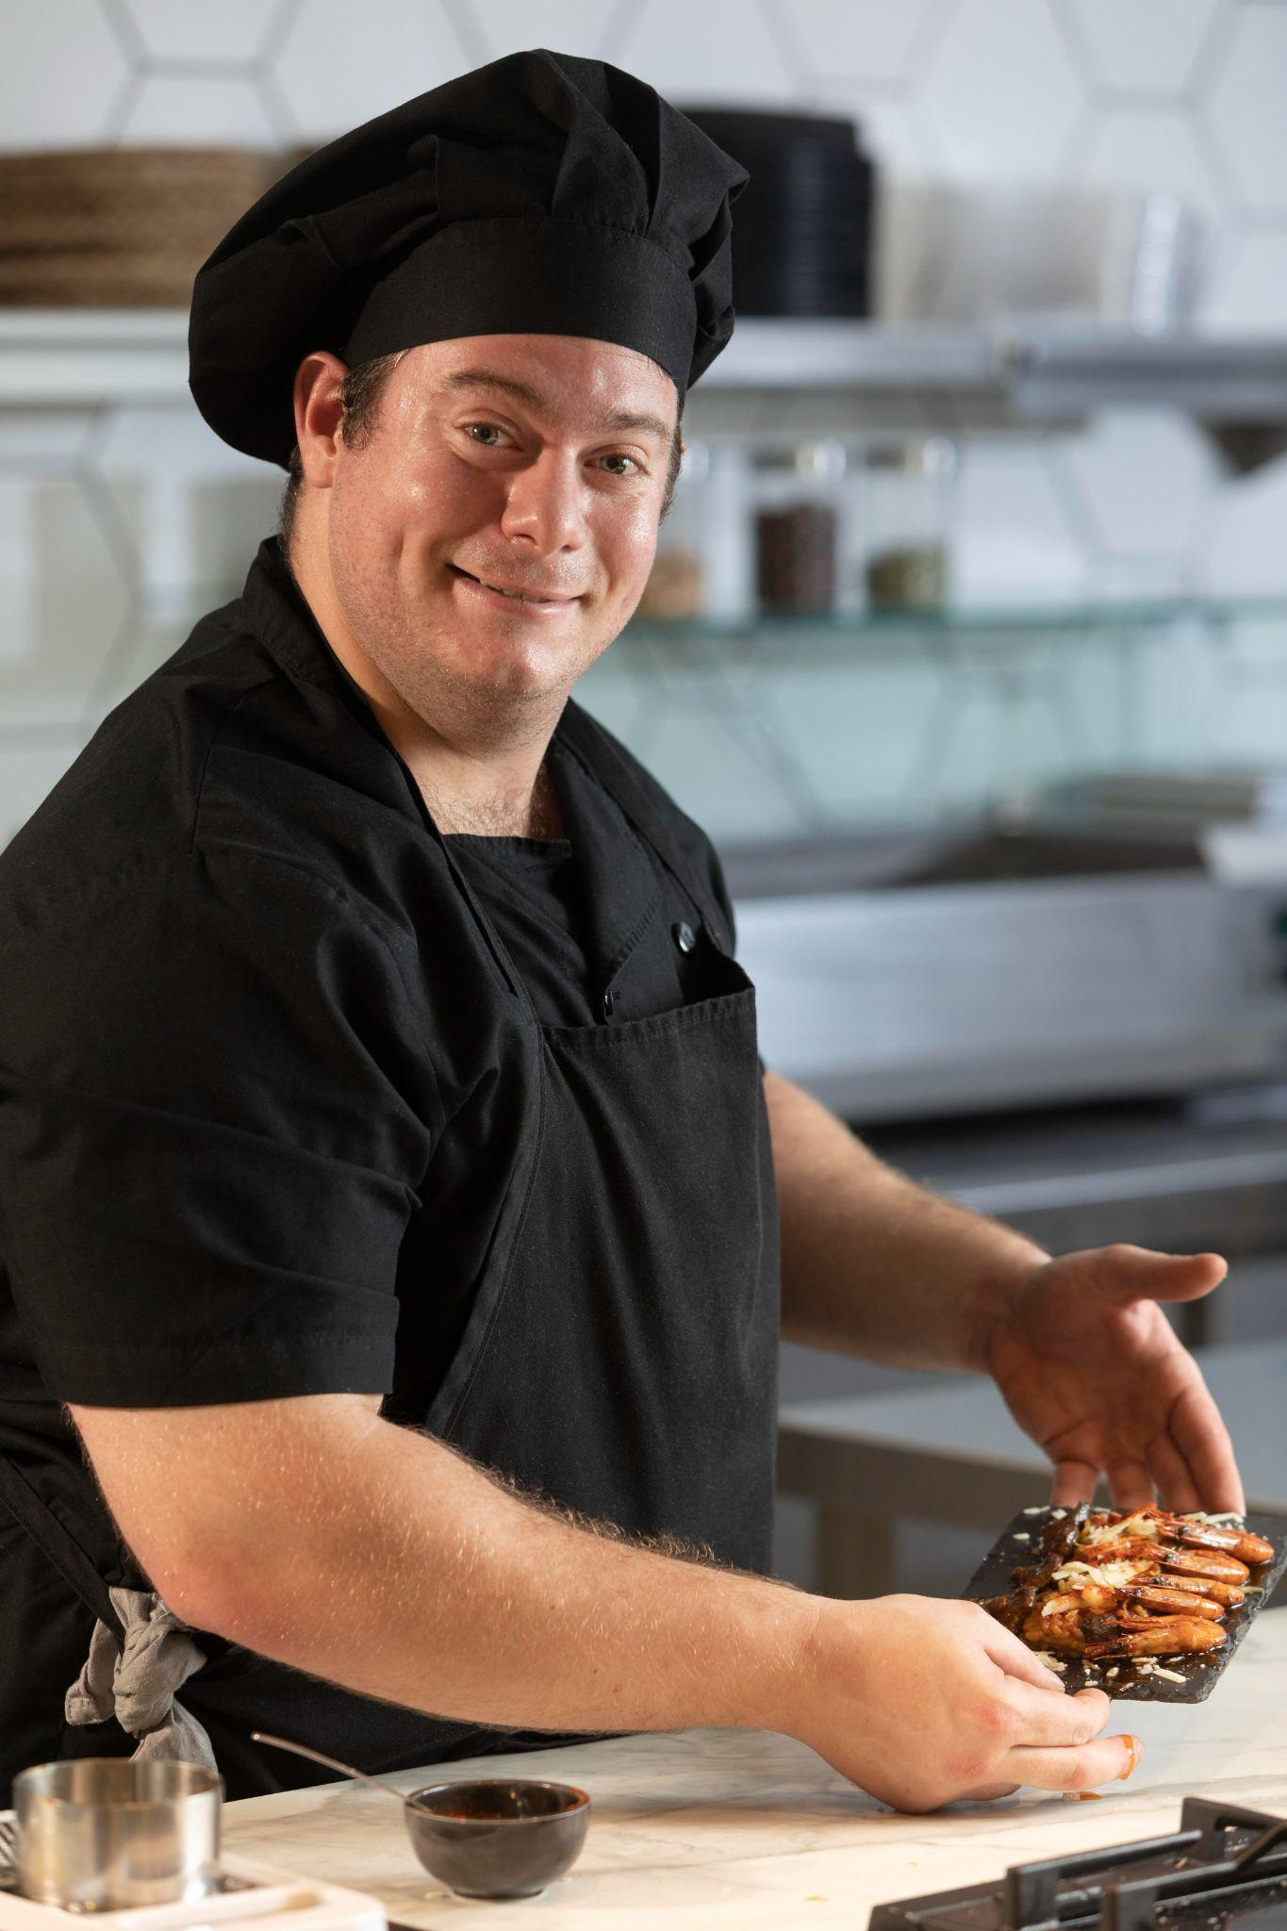
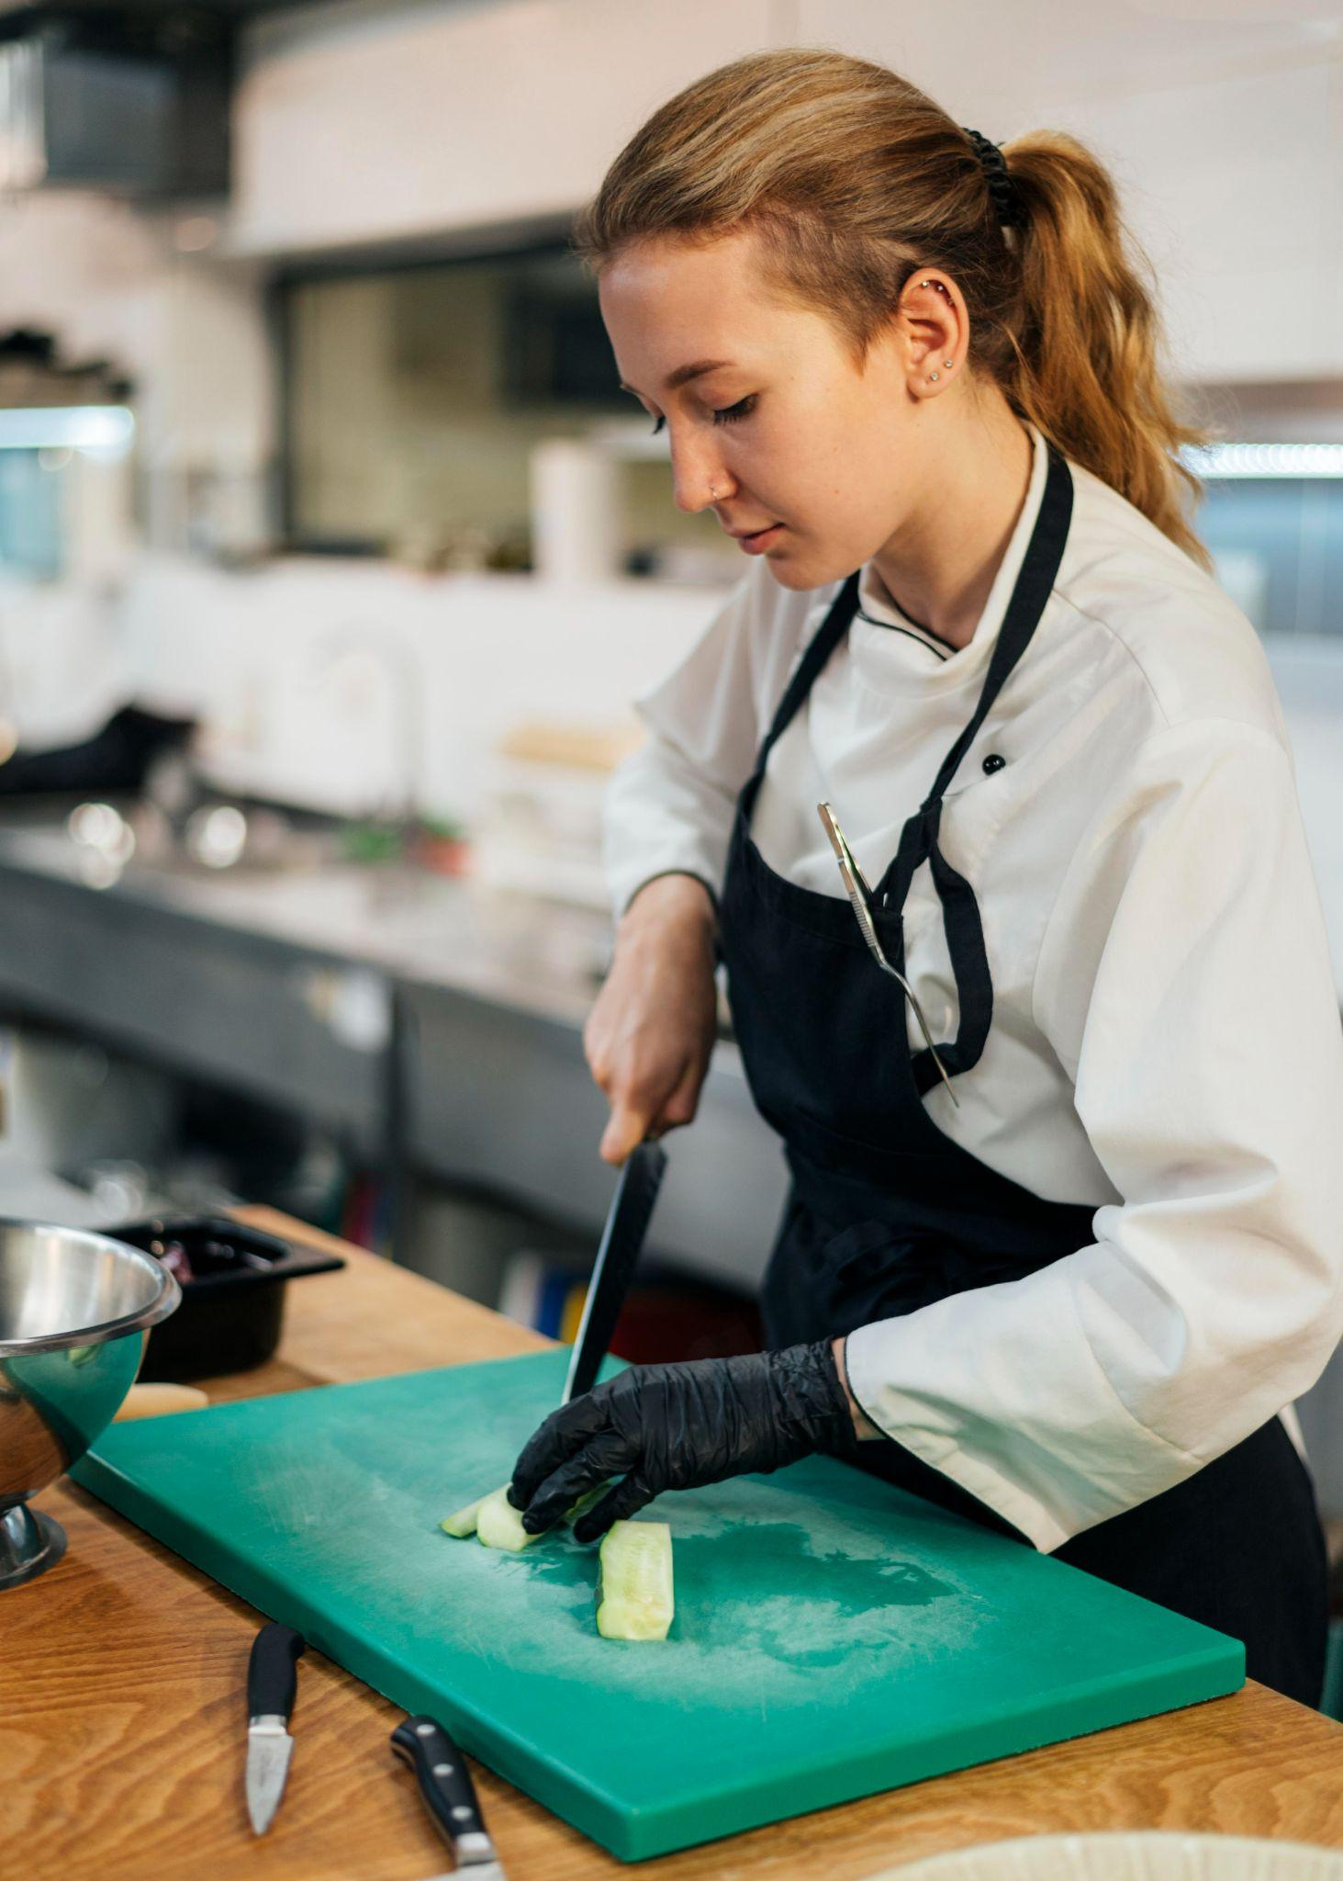
Target Audiences
Steve, 40 years old
Amanda, 30 years old
Just started learning how to cook
Need easy, step by step recipes
Wants reliable access to recipes
Skilled and creative in the kitchen
Wants to share recipes with others
Innovative, social

Slide 4
Competitor Analysis
Samsung Food
Strengths
Weaknesses
Has meal planning and grocery list integration
Supports dietary preferences
Interface is user-friendly
Able to import recipes from Instagram and tiktok
Able to schedule recipes
If the external source is not coded specifically for recipes, it can only show the link to the original source
No way of communicating with other users of the app

Slide 5
Competitor Analysis
RecipeKeeper
Strengths
Weaknesses
Able to scan from cookbooks and handwritten recipes
Able to share recipes to email
Features a way to mark recipes as favorites
Has no dietary preferences
Limited free uses

Slide 6
Proposed Features
User features
Core features
UI elements
User can add their own handmade recipes
Login Page
Access a community page to discuss recipes with other users
Have dietary preferences as a setting
Calendar page to encourage recipe planning
Recipe sharing
Bottom navigation bar
Dropdown details of the recipe when you click on the image of the food

Slide 7
Screen examples

Slide 8
Timeline
Week 4 | Set up the bottom navigation bar with placeholder
Week 5 | Implement Image picker and set up room database Build a grid to display recipes
Study Break | Integrate firebase authentication Add datastore for dietary preferences
Week 6 | Implement expandable cards Add recipe sharing
Week 7 | Create a community screen
Week 8 | Add CalendarView Apply Room relationship
Week 9 | Final bug fixes and submit!

Slide 9






GitHub
https://github.com/RichoWT7/Mobile-Computing-/tree/main

Slide 11
Instructions for use
If you have a free account, in order to use this template, you must credit Slidesgo by keeping the Thanks slide. Please refer to the next slide to read the instructions for premium users.
As a Free user, you are allowed to:
Modify this template.
Use it for both personal and commercial projects.
You are not allowed to:
Sublicense, sell or rent any of Slidesgo Content (or a modified version of Slidesgo Content).
Distribute Slidesgo Content unless it has been expressly authorized by Slidesgo.
Include Slidesgo Content in an online or offline database or file.
Offer Slidesgo templates (or modified versions of Slidesgo templates) for download.
Acquire the copyright of Slidesgo Content.
For more information about editing slides, please read our FAQs or visit our blog:
https://slidesgo.com/faqs and https://slidesgo.com/slidesgo-school

Slide 12
Instructions for use (premium users)
As a Premium user, you can use this template without attributing Slidesgo or keeping the "Thanks" slide.
You are allowed to:
Modify this template.
Use it for both personal and commercial purposes.
Hide or delete the “Thanks” slide and the mention to Slidesgo in the credits.
Share this template in an editable format with people who are not part of your team.
You are not allowed to:
Sublicense, sell or rent this Slidesgo Template (or a modified version of this Slidesgo Template).
Distribute this Slidesgo Template (or a modified version of this Slidesgo Template) or include it in a database or in any other product or service that offers downloadable images, icons or presentations that may be subject to distribution or resale.
Use any of the elements that are part of this Slidesgo Template in an isolated and separated way from this Template.
Register any of the elements that are part of this template as a trademark or logo, or register it as a work in an intellectual property registry or similar.
For more information about editing slides, please read our FAQs or visit our blog:
https://slidesgo.com/faqs and https://slidesgo.com/slidesgo-school

Slide 13
Fonts & colors used
This presentation has been made using the following fonts:
Averia Serif Libre
(https://fonts.google.com/specimen/Averia+Serif+Libre)
Baloo 2
(https://fonts.google.com/specimen/Baloo+2)
#51271d
#f6efeb
#fee0c4
#e44c40
#cb2127
#f8a41c
#cc6600
#abb94b
#7b8b41
#bf8e73

Slide 14

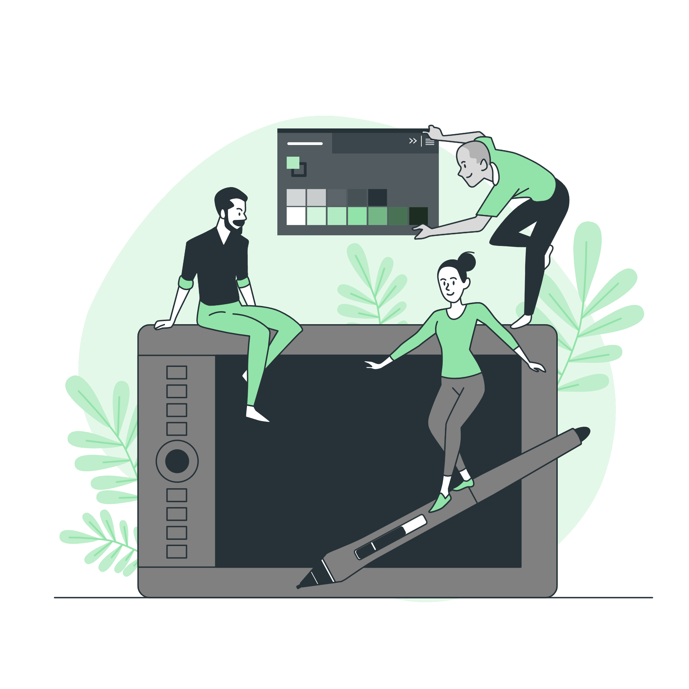



Storyset
Create your Story with our illustrated concepts. Choose the style you like the most, edit its colors, pick the background and layers you want to show and bring them to life with the animator panel! It will boost your presentation. Check out how it works.
Pana
Amico
Bro
Rafiki
Cuate

Slide 15
Use our editable graphic resources...
You can easily resize these resources without losing quality. To change the color, just ungroup the resource and click on the object you want to change. Then, click on the paint bucket and select the color you want. Group the resource again when you’re done. You can also look for more infographics on Slidesgo.

Slide 18
JANUARY
FEBRUARY
MARCH
APRIL
MAY
JUNE
PHASE 1
Task 1
Task 2
PHASE 2
Task 1
Task 2
JANUARY
FEBRUARY
MARCH
APRIL
PHASE 1
Task 1
Task 2

Slide 21
...and our sets of editable icons
You can resize these icons without losing quality.
You can change the stroke and fill color; just select the icon and click on the paint bucket/pen.
In Google Slides, you can also use Flaticon’s extension, allowing you to customize and add even more icons.

Slide 22
Educational Icons
Medical Icons

Slide 23
Business Icons
Teamwork Icons

Slide 24
Help & Support Icons
Avatar Icons

Slide 25
Creative Process Icons
Performing Arts Icons

Slide 26
Nature Icons

Slide 27
SEO & Marketing Icons

